Slide 1
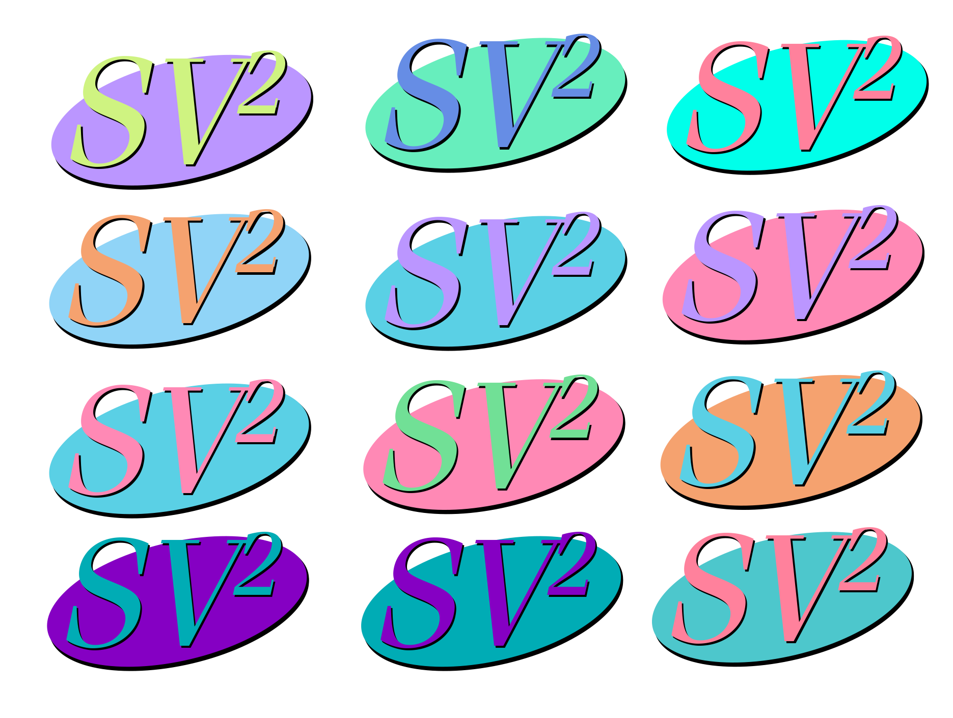
Genotyping SV with Machine Learning
Danny Antaki, Sebat Lab
August 18, 2017
https://github.com/dantaki/presentations/tree/master/advanced_statistics

Slide 2

Outline
Background
Training classifiers
Evaluating classifiers
SV² performance and future goals

Slide 3

What is Structural Variation (SV)
Structural Variation is a change of the structure of a chromosome greater than 50bp
Simply: DNA rearrangement
Includes:
Deletions
Duplications
Inversions
Insertions
Translocations
Complex Rearrangements
Classes of Sequence Mutations
SNP: 1bp
INDEL: 2bp-49bp
SV: >50bp
Reference
GATCGATC
GAGCGATC
GAT--CGATC
GAGAG-GATC
Mutation

Slide 4
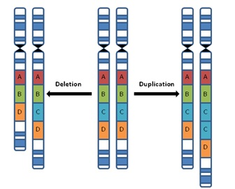
Copy Number Variation
A change in the copy number. Typically either a gain (duplication) or loss (deletion)
Homozygous Deletion: 0 copies
Heterozygous Deletion: 1 copy
Homozygous neutral : 2 copies
Heterozygous Duplication : 3 copies
Homozygous Duplication : 4 copies

Slide 5
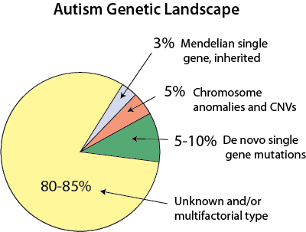
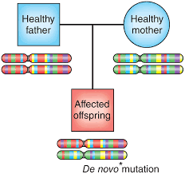
SV and Autism
Autism has a strong genetic component
70-90% MZ Twin Concordance
Idiopathic Autism cases are enriched for de novo mutations
5-10% of cases have a casual de novo SV
Validating de novos is tough!
A new mutation originated from the mother confers risk to the offspring. De novo mutations explain how a genetic disease can occur without previous family history

Slide 6
The problem with de novos …
Initial SV calls have high rates of False Positives
~40% FDR
False positive SVs in children appear de novo
How do we filter SV without being too strict?
Machine Learning 😀💻

Slide 7
Machine Learning Validation of SV
SV² (support-vector SV genotyper) uses machine learning to genotype SV
Why machine learning?
We can create models that “learn” from real examples: “supervised”
Some models use non-linear kernels
Goals:
Better accuracy than other SV genotyping solutions
Sensitive for de novo mutation discovery
User-friendly and fast execution time

Slide 8
So you wanna make machines learn
We need features: measureable property that should be useful in discriminating between classes
4 features were selected a priori based on previous use in SV calling algorithms
Most SV calling/genotyping tools use 2

Slide 9
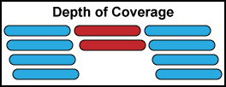
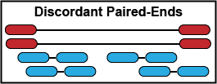
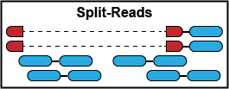
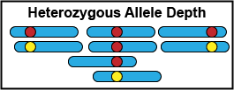
Features of SV in Next-Gen Sequencing
Coverage: Number of reads spanning the SV
Discordant Paired-Ends: abnormal insert sizes
Split-Reads: reads that span SV breakpoints
Heterozygous Allele Depth Ratio:
Duplications only

Slide 10
Defining classifiers
Classifiers are models that assign a class to a variable
Here classes are genotypes (0/0, 0/1, 1/1)
SV² uses 6 classifiers
Based on
SV type
SV feature availability
possible genotypes (male sex chromosomes)

Slide 11
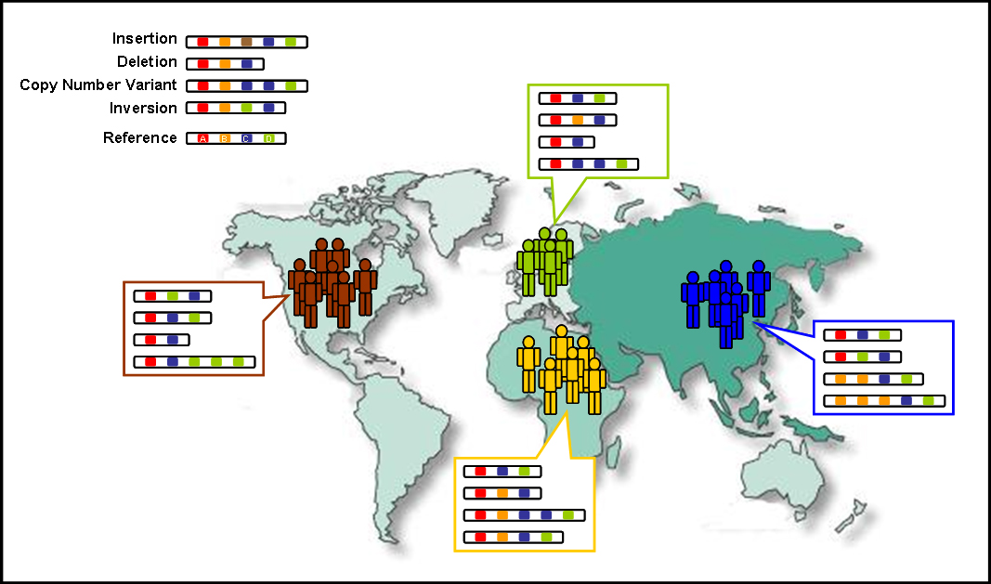
Obtaining a Training Set
We need
Samples (NG-WGS)
Gold Standard SV callset
1000 Genomes Project 😍
Phase 3 SV callset ~1-4%FDR
1000 Genomes Phase 3 SV Training Set
SV Type | Classifier | HOM REF | HET | HOM ALT | Samples (N) | Mean Coverage
Deletion | SV > 1000bp | 84260 | 10687 | 3191 | 27 | 48x
Deletion | SV <= 1000bp | 51280 | 10744 | 3784 | 27 | 48x
Duplication | SNV | 7758 | 554 | 460 | 27 | 48x
Duplication | Breakpoint | 99072 | 18958 | 1911 | 2494 | 7x
Deletion | Sex Chromosome in Males | 3846 | - | 191 | 27 | 48x
Duplication | Sex Chromosome in Males | 200 | - | 195 | 311 | 7x

Slide 12
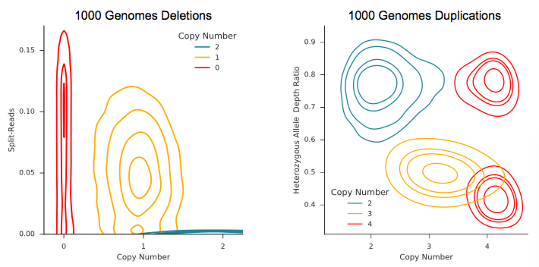
Visualizing SV² Training Features
Deletions < 1000bp classifier. Copy Number is a function of coverage.
Duplications with heterozygous allele depth features.
Aa
AAaa
AAa
AAAa
The distribution of the data are clearly non-linear. Support Vector Machine classifier with a Radial Basis Function Kernel can take advantage of the non-linearity

Slide 13
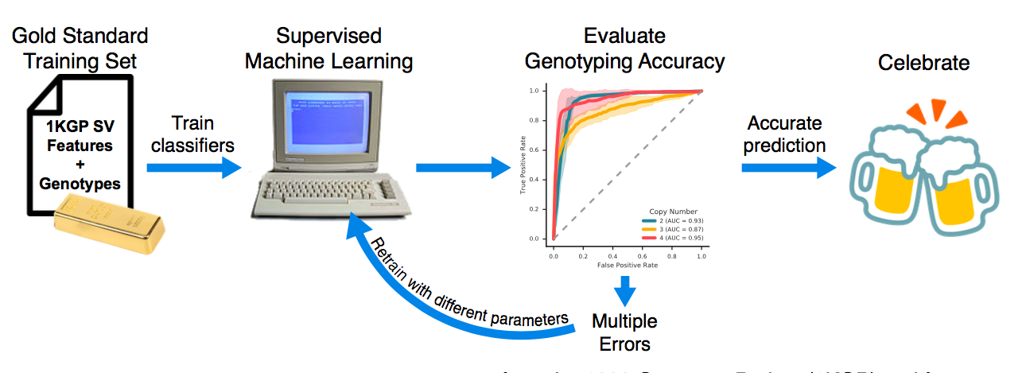
Now we train
Breakdown of training a machine learning classifier

Slide 14
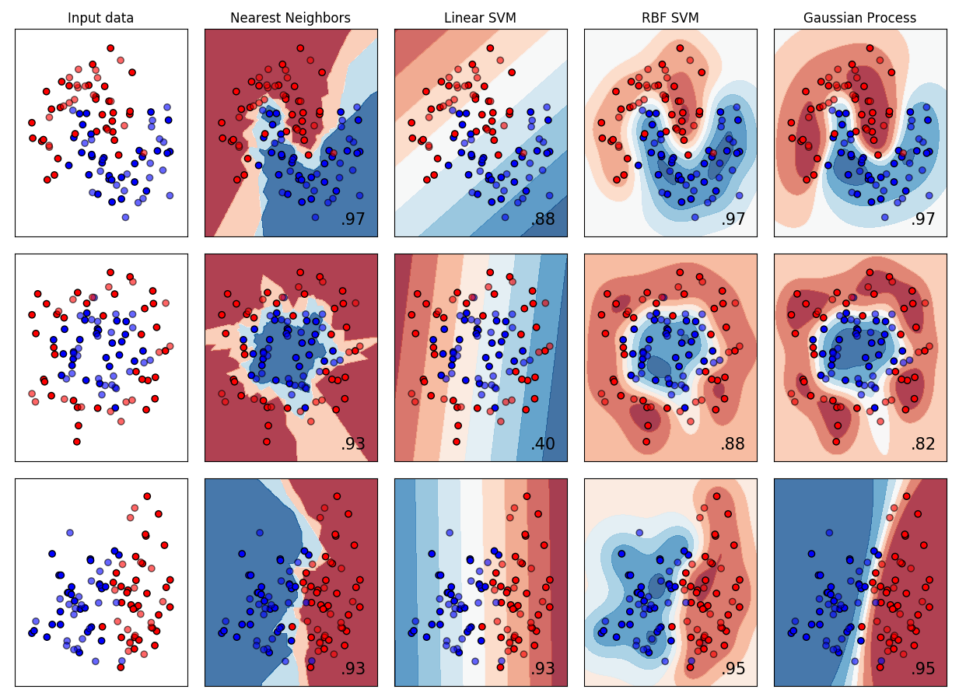
Evaluating multiple models
Your mileage may vary!
Training set and classification problem should influence the types of models to test
Big vs Small Data, Categorical vs Quantitative
Cheat sheet: http://scikit-learn.org/stable/tutorial/machine_learning_map/index.html
Compare models code:http://scikit-learn.org/stable/auto_examples/classification/plot_classifier_comparison.html
Due to the non-linearity of the data and performance estimates, SV² implements a Radial Basis Function (RBF) kernel

Slide 15
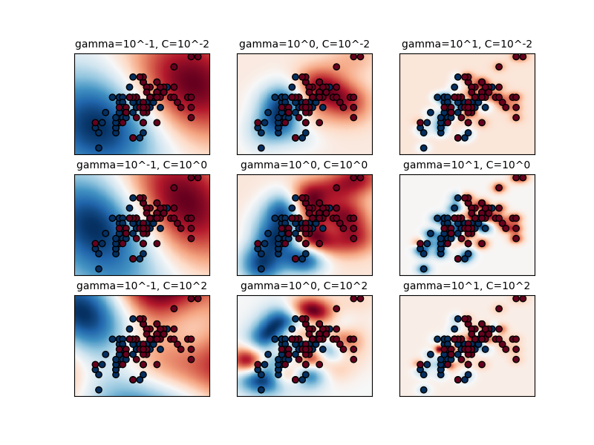
Evaluating model parameters
RBF kernels are governed by two parameters
C: trade off between error and the decision boundary
Gamma: how well each sample influences the decision boundary
Perform a parameter sweep using cross validation as a performance metric
Cross validation
divide training set into two
One to train, one to test
http://scikit-learn.org/stable/auto_examples/svm/plot_rbf_parameters.html#sphx-glr-auto-examples-svm-plot-rbf-parameters-py

Slide 16
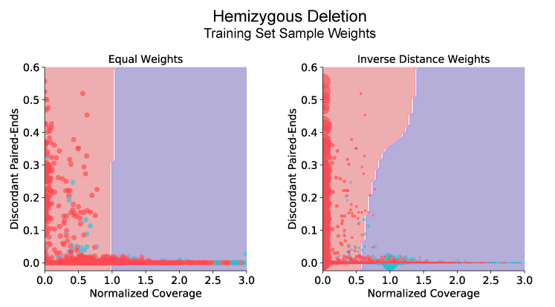
Fine tuning with sample weights
Applied an inverse-distance weight to the expected coverage value
CN 0 = 0.0
CN 1 = 0.5
CN 2 = 1.0
Decision boundaries with equal sample weights (left) and inverse distance weights (right). The red shade assigns the ALT genotype; blue is REF.
The size of each point is proportional to the sample weight

Slide 17
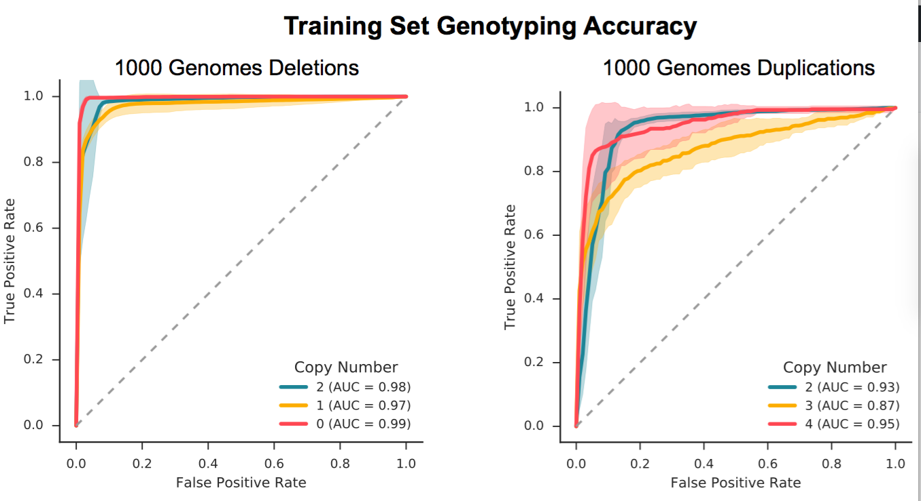
SV² Cross Validation
ROC curves of the optimal parameters of classifiers. 7-fold cross validation was performed, maintaining the same proportion of the classes in each fold to the original training set. Shaded areas represent 95%CI of each fold.

Slide 18
Extending Parameter Selection
We have an independent evaluation set (WGS of ASD families)
Includes SNP microarrays as an orthogonal method to detect SV
FDR estimates from microarrays aided with parameter selection
Keeping in mind sensitivity for de novo mutations
Autosome Deletion (> 1000bp) classifier performance
C | gamma | Total DNMs | DNM sensitivity | Rare CNVs | Rare CNV FDR (%)
0.01 | 1 | 13 | 1 | 1553 | 8
0.01 | 10 | 8 | 0.875 | 2286 | 1.5
0.1 | 10 | 7 | 0.875 | 1342 | 4.2
1 | 10 | 8 | 0.875 | 2558 | 2.9

Slide 19
We must evaluate more 😓
Moar genomes (N=1884)
Moar platforms (N=9 Pacific Biosciences long reads)
Test performance at varying probability cutoffs
False discovery rates of the final classifiers with respect to the genotype likelihood. Both microarrays and long reads were used
The transmission disequilibrium test is a robust measure of genotype accuracy. 50% of variants are transmitted from a parent to a child; deviations from the null distribution are due to genotype errors. Shaded areas represent 95% CI.

Slide 20
Test our performance with others
SVTyper relies on split-reads and discordant paired-ends; it’s a Bayes method. Manta is a probabilistic genotyper designed by Illumina. SV² has the optimal performance across each SV class and size.

Slide 21
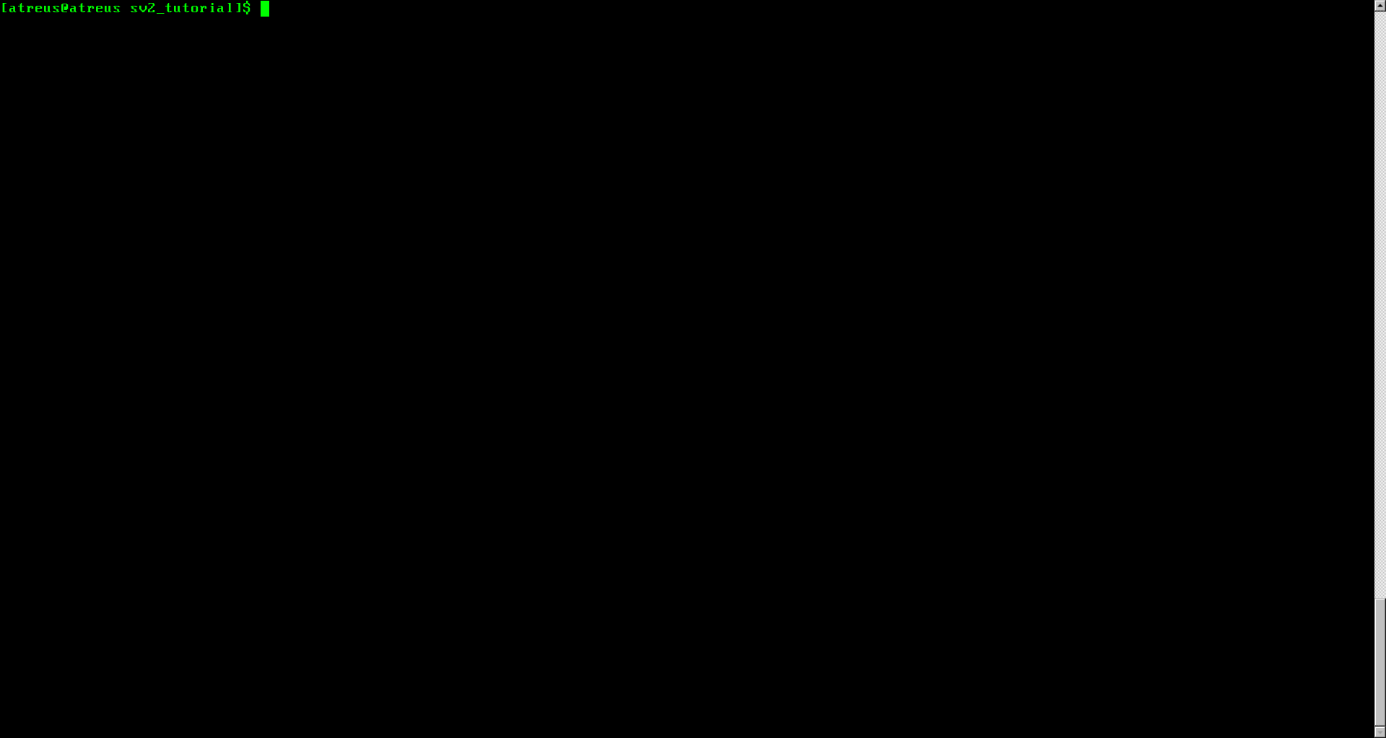
Wrapping it up
https://github.com/dantaki/SV2
SV² implements machine learning to genotype deletions and duplications
SV² performance is better than existing genotypers

Slide 22
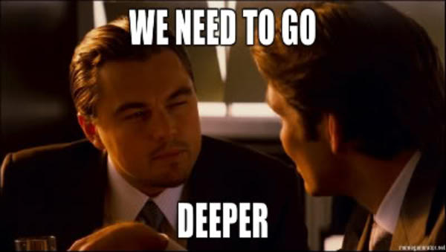
Moving forward
What about inversions and insertions?
What about 3rd generation sequencing (long-reads)
Solution: deep learning

Slide 23
Deep Learning with images
Google’s DeepVariant uses images to genotype SNV and INDELs with a Convolutional Neural Network
Better than GATK (by 1%)!
Why not extend this to SV?
🔧🚧 WIP🔧🚧
Deletion
Duplication
Inversion
Insertion
Images of SV from PacBio long reads. White pixels are clipped positions. Green alignments are on opposite strands. Read reads are insertions

Slide 24

Questions?
Slides on github https://github.com/dantaki/presentations/tree/master/advanced_statistics

